Slide 1



NeuroSystolixV: Edge AI SoC for DNN applications
Research Work Progress
Mr. Bandi Dinesh
Nanoscale Devices, VLSI Circuit & System Design Research Group, Department of Electrical Engineering, Indian Institute of Technology Indore

Slide 2
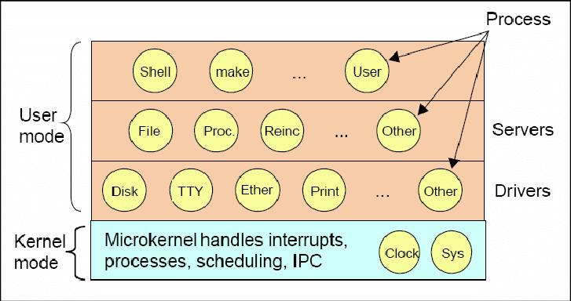
Studied the Concepts of Operating System
An operating system (OS) is a piece of software that manages computer hardware and software resources and provides services for computer programs.
The Operating System has many architectures.Most prominent ones are microkernel and monolithic kernel architectures.
Every operating system has a kernel which is the heart of an operating system, providing essential services that allow the hardware and software to interact efficiently and securely.
There are some processes which are important for working of an operating system which are
File Server
Process Manager
Memory Manager
Reincarnation Server
Device Drivers
Interrupts
Scheduling
IPC
Out of these processes, the one which has importance in our project is Scheduling.

Slide 3
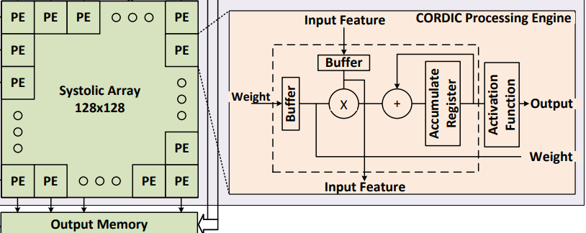
In our Edge AI SoC, We perform computations in the systolic array of 128x128 PE’s which perform MAC’s and Activating Function calculations.
Systolic arrays have a grid-like structure where each PE is connected to its neighbors.
Each PE only communicates with its immediate neighbors, reducing the complexity and power consumption associated with long-distance data transfer.
It has pipelined operation and parallel processing.
In this type of computation, Scheduling is a very important task.
Scheduling of the systolic array includes Timely Data Arrival,Avoiding Data Hazards, Efficient Use of PEs and Overlap of Computations through pipelining
It enables Uniform Work Distribution,Optimal Resource Utilization and Power Efficiency.
Unfortunately, normal scheduling algorithms like FCFS,Round Robin,SJF and MLFQ doesn't work here as these deal with tasks of varying priorities and behaviors that require dynamic adjustment.
Systolic arrays are designed for specific, repetitive tasks like matrix multiplication or convolution operations.

Slide 4
Some of the common scheduling algorithms used for systolic arrays are static scheduling,dynamic scheduling,list scheduling,etc..
Each of these scheduling algorithms have their tradeoffs.
The scheduling algorithm used in AuRORA framework is dynamic and focused on the real-time allocation and release of accelerators based on task deadlines and system load.
The framework uses a dynamic deadline score (ddl_score) to determine the urgency of tasks. This score is calculated based on the slack time available before the deadline and the estimated latency of the task execution​​.
The `Analyze` function within the AuRORA runtime compares the deadline scores of different tasks to decide whether to release or acquire accelerators. This decision-making process ensures that accelerators are allocated to tasks that are most in need based on their deadlines​​.
AuRORA also includes a NUMA-aware partitioning strategy to optimize the placement of accelerators and memory. This helps in reducing the performance impact due to non-uniform memory access (NUMA) effects, which is crucial for maintaining efficiency in a multi-accelerator environment​​.

Slide 5
AuRORA could potentially be applied or extended for systolic arrays too.
AuRORA's capability for dynamic resource allocation could be extended to manage systolic arrays.
This would involve dynamically allocating processing elements of the systolic array to different tasks or applications based on their current demands.
For example, different parts of the systolic array could be assigned to different neural network models or matrix operations as needed.
AuRORA's approach to virtualized accelerator integration could be adapted to systolic arrays.
This might involve abstracting the systolic array as a virtualized resource that can be dynamically allocated and used by multiple tasks concurrently.
AuRORA's framework could potentially manage the orchestration of systolic array resources to efficiently handle multiple concurrent workloads.
This would involve preemptive allocation and dynamic partitioning of the systolic array resources based on workload demands.

Slide 6
Thank You !!

